Slide 1
WELCOME TO
STRATEGIC IT & E-COMMERCE
Ciaran Hayden
Email: ciaran.hayden@ncirl.ie

Slide 2
COURSE OVERVIEW
Information Systems for Organisational Performance
IT Infrastructure
Process design
System architecture
Salesforce.com
Operational and Enterprise Systems
Web, Mobile, Social Media Strategies
Managing IT Projects/Processes
Legal Factors
E-Commerce and E-Marketplaces

Slide 3
Class Outline
Positioning IT to Optimize Performance
Information Systems and IT: Core Concepts
Business Performance Management (BPM) and Measurement
Strategic Planning and Competitive Models
Why IT is Important to Your Career, and IT Careers

Slide 4
Learning Objectives
Understand the role of IT in optimizing performance.
Explain why the business value of IT is determined by people, business processes, & organizational culture.
Describe the role of IT in business performance management (BPM) & the performance measurement process.
Understand the strategic planning process, SWOT (strengths, weaknesses, opportunities, threats) analysis, & competitive models.
Discuss how IT impacts your career & the positive outlook for IS management careers.

Slide 5
Positioning IT to Optimize Performance
Business performance depends on:
AGILITY: Importance of being an agile enterprise (able to adapt rapidly) has never been greater because of bad economic conditions and advances in mobile technology.
MOBILITY: Connect with customers anywhere/time. The shift from PCs to mobile devices has made location irrelevant to a large extent.
Touch-navigate devices running on 3G & 4G networks together with innovative IT (e.g., 2D tags) create business opportunities.

Slide 6
IT creates a competitive edge — until it’s duplicated by a competitor or replaced by newer technology
Past decade: companies were adapting to social networking. Facebook, LinkedIn, YouTube, Twitter and blogs became extensions of businesses to reach customers, prospects, and business partners.
Today: companies want to grab the attention of potential and current customers on their mobiles. Companies are developing ways to connect with & push content to social networks and mobile devices.

Slide 7
The business environment is changing, for example: |  | Prompting operations responses, for example:
Increased cost-based competition Higher quality expectations Demands for better service More choice and variety Rapidly developing technologies Frequent new product/service introduction Increased ethical sensitivity Environmental impacts are more transparent More legal regulation Greater security awareness |  | Globalization of operations networking Information-based technologies Internet-based integration of operations activities Supply chain management Customer relationship management Flexible working patterns Mass customization Fast time-to-market methods Lean process design Environmentally sensitive design Supplier ‘partnership’ and development Failure analysis Business recovery planning

Slide 8
Innovation leads to profitable growth if that innovation does one or more of the following:
Generates new profit pools
Increases demand for products and services
Attracts new customers
Opens new markets
Sustains the business for years to come

Slide 9
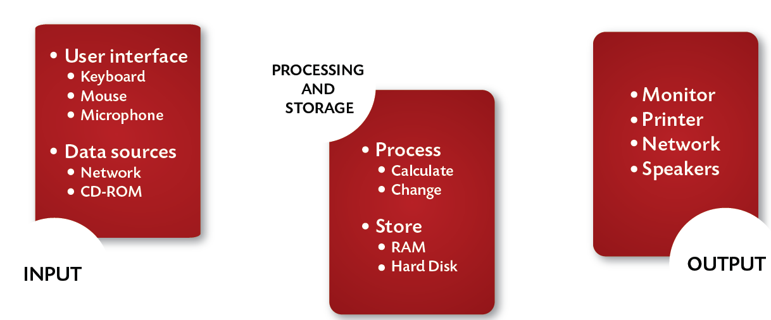
Information Systems and IT: Core Concepts
Figure 1.3 Four Basic Functions of an Information System: Input, Processing, Storage, & Output

Slide 10
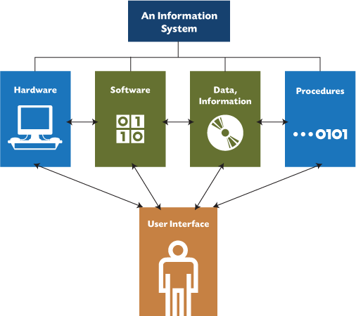
Figure 1.4 Components of Information Systems

Slide 11
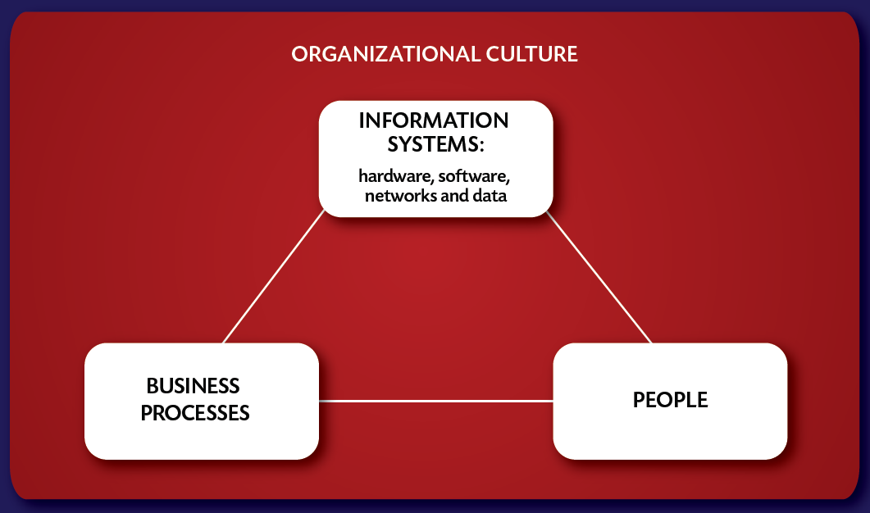
IS value is determined by the relationships among ISs, people, & business processes—all of which are influenced by organizational culture
Figure 1.5 Information Systems Function Within a Culture

Slide 12
Business Performance Management (BPM) and Measurement
To manage performance, 2 basic requirements are:
Being able to measure. You cannot manage what you cannot measure. The more accurate & timely the data, the better the ability to measure.
Knowing that your indicator is measuring the right thing. Not all performance metrics are clearly linked to the desired outcome.
Consider how much easier it is to measure sales revenues than to measure customer loyalty.

Slide 13
Measuring business performance requires:
identifying the most meaningful measures of performance
being able to measure them correctly
selecting the set of measures that provides a holistic indicator of total business performance, and
identifying who should receive the reports and in what timeframe

Slide 14
Business Performance Measurement (BPM) Process
Major steps in BPM are:
Step 1. Decide on desired performance levels.
Step 2. Determine how to attain the performance levels.
Step 3. Periodically assess where the organization stands with respect to its goals, objectives, and measures.
Step 4. Adjust performance and/or goals.
If performance is too low, corrective actions need to be taken to close the gap.

Slide 15
Strategic Planning and Competitive Models
Strategy defines the plan for how a business will achieve its mission, goals, and objectives.
Strategy planning is critical for all organizations, including for-profits, nonprofits, government agencies, healthcare, education, military, and social services.
Strategic analysis is the scanning and review of the political, social, economic and technical environment of the organization.
SWOT analysis involves the evaluation of strengths and weaknesses, which are internal factors; and opportunities and threats, which are external factors.

Slide 16
Basis of Porter’s Competitive Forces Model
Before examining the competitive forces model, it’s helpful to understand that it is based on the concept of profitability and profit margin.
PROFIT = TOTAL REVENUES - TOTAL COSTS
PROFIT MARGIN = SELLING PRICE - COST OF THE ITEM
Profit margin measures the amount of profit per unit of sales, and does not take into account all costs of doing business.

Slide 17
Porter’s 5 competitive forces model
Threat of entry of new competitors
Bargaining power of suppliers
Bargaining power of customers or buyers
Threat of substitute products or services
Competitive rivalry among existing firms in the industry

Slide 18
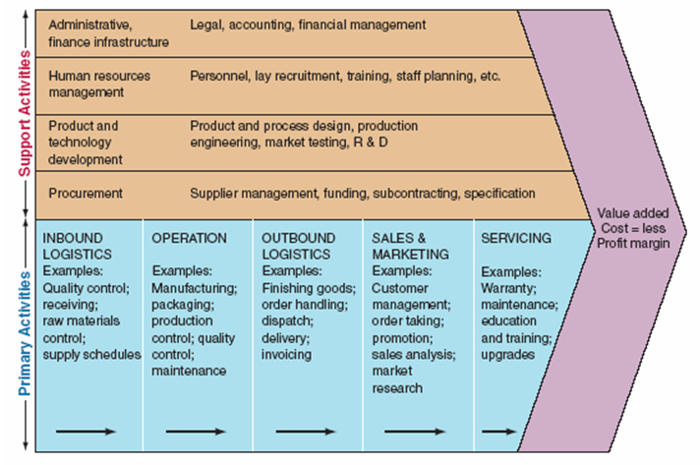
Figure 1.9 The firm’s value chain, with arrows illustrating the flow of goods and services

Slide 19
IT Failures
Some IT projects are doomed from the start because of inadequate budgeting and/or other necessary resources.
On February 24, 2008, about 2/3 of the world was unable to see YouTube for several hours. This happened when the Pakistan Telecommunication Authority decided to block offensive content in their own country.
The UK National Offender Management Information System project (NOMIS) failed due to mismanagement and vast budget overruns.
The U.S. Census Bureau faced a $2 billion loss on an IT project to replace paper-based data collection methods with handheld devices for the 2010 census. The Bureau had to scrap the project.

Slide 20
IT is Important to Your Career, and IT Careers
Business is IT-dependent
For most organizations, if their computer network goes down, so does the business
Imagine not having Internet access for 24 hours--no texting, e-mail, Facebook, Twitter, Google, data access, etc.
How would that impact your life?

Slide 21
IT as a Career: The Nature of IS and IT Work
In today’s workplace, it is imperative that ISs work effectively and reliably.
IS managers play a vital role in the implementation and administration of technology within their organizations.
They plan, coordinate, and direct research on the computer-related activities of firms.
In consultation with other managers, they help determine the goals of an organization and then implement technology to meet those goals.
They oversee all technical aspect of an organization, such as software development, network security, and Internet operations.

